Slide 1
This shape is a kite.
There are 2 ways we can look at the area of a kite.
1. We can rearrange the kite to make a rectangle.
Length
Width

Slide 2
This shape is a kite.
There are 2 ways we can look at the area of a kite.
1. We can rearrange the kite to make a rectangle.
Length
Width
By doing this we can see that the area of a kite is the same as a rectangle that is half the width of the kite.

Slide 3
This shape is a kite.
There are 2 ways we can look at the area of a kite.
We can rearrange the kite to make a rectangle.
We can make a rectangle that fits around our kite.
Only ½ this section of the rectangle contains the kite
Length
Width
By doing this and looking at each section of the kite we can see that the area of a kite only takes up half the area of a rectangle of the same length and width.

Slide 4
This shape is a kite.
There are 2 ways we can look at the area of a kite.
We can rearrange the kite to make a rectangle.
We can make a rectangle that fits around our kite.
Only ½ this section of the rectangle contains the kite
Length
By doing this and looking at each section of the kite we can see that the area of a kite only takes up half the area of a rectangle of the same length and width.
Width

Slide 5
This shape is a kite.
There are 2 ways we can look at the area of a kite.
We can rearrange the kite to make a rectangle.
We can make a rectangle that fits around our kite.
Length
By doing this and looking at each section of the kite we can see that the area of a kite only takes up half the area of a rectangle of the same length and width.
Width
Only ½ this section of the rectangle contains the kite

Slide 6
This shape is a kite.
There are 2 ways we can look at the area of a kite.
We can rearrange the kite to make a rectangle.
We can make a rectangle that fits around our kite.
Length
By doing this and looking at each section of the kite we can see that the area of a kite only takes up half the area of a rectangle of the same length and width.
Only ½ this section of the rectangle contains the kite
Width

Slide 7
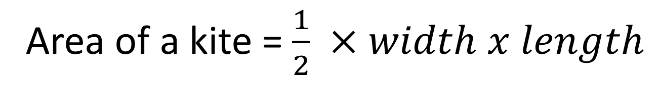
This shape is a kite.
There are 2 ways we can look at the area of a kite.
We can rearrange the kite to make a rectangle.
We can make a rectangle that fits around our kite.
Length
Whichever way you look at it….
Width
Area of a kite = $\frac{1}{2} ×width x length$

Slide 8
This shape is a Rhombus.
A rhombus (and a parallelogram) are measured in width and perpendicular height.
We can rearrange the rhombus to make a rectangle.
We can therefore see that;
Width
height
Area of a Rhombus = width x perpendicular height

Slide 9
This shape is a Trapezium.
We can double (and flip) the Trapezium to make a parallelogram
Width A
height
Width B

Slide 10
This shape is a Trapezium.
We can double (and flip) the Trapezium to make a parallelogram
Width A
Width B
Area of a parallelogram = height x width
= height x (width A + width B)
But since we only want the trapezium that takes up half this area
height
Width B
Width A
Area of trapezium = $\frac{1}{2}×$height x (width A + width B)

Slide 11
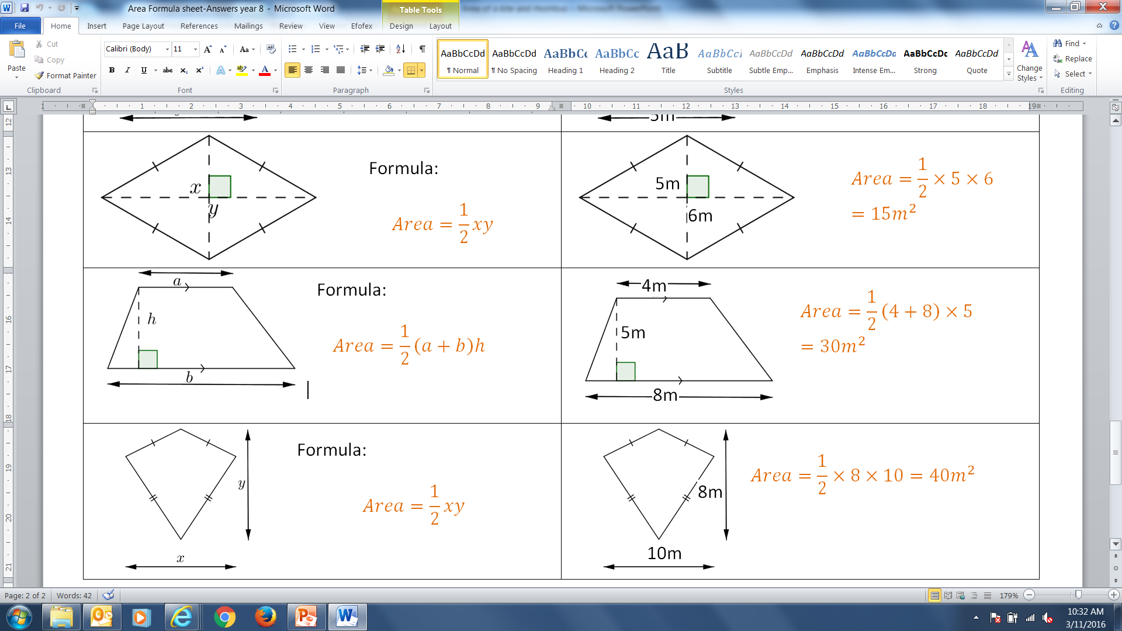
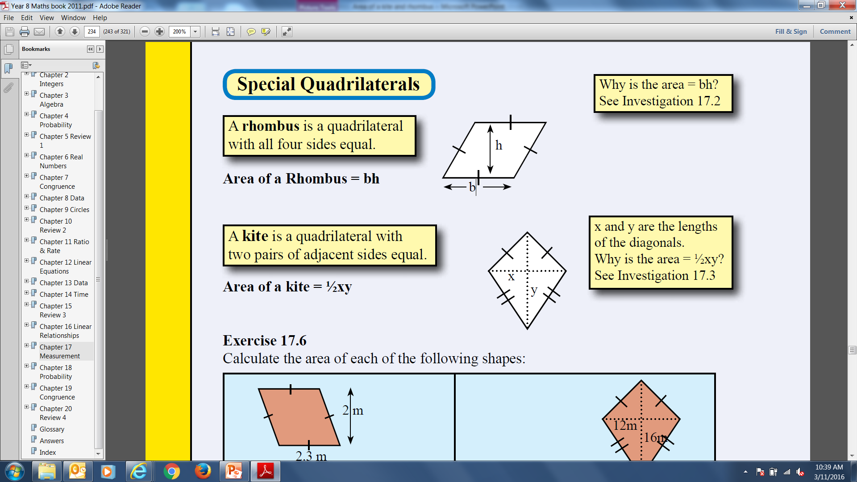
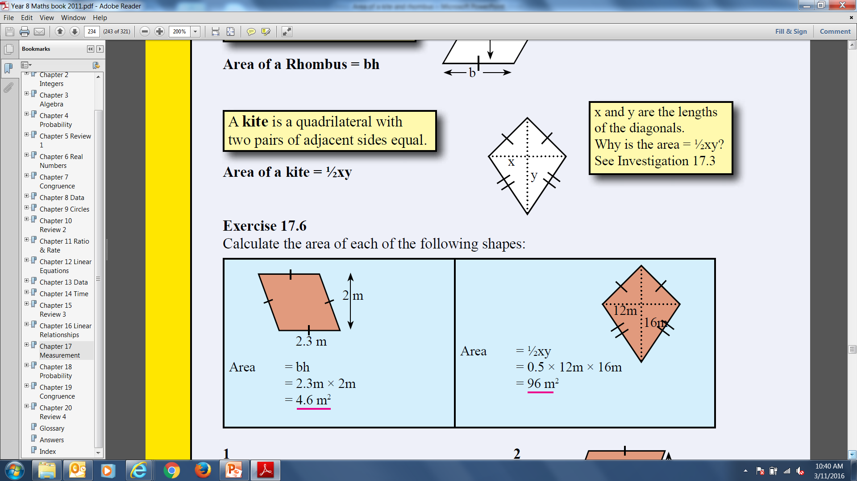
24
7
30
Date
Topic: Area of Kites and Rhombuses
EQ – How do I find the area of a kite?
Kite:
Example:

Slide 12
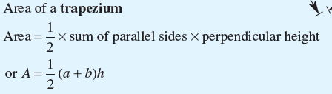
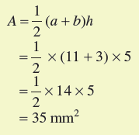
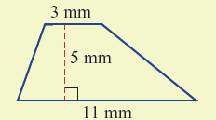
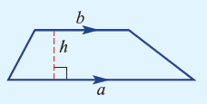
24
7
30
Date
Topic: Area of Kites and Rhombuses
EQ – How do I find the area of a kite?

Slide 13
Let’s try some together.
9m
3
7cm
4
13cm

Slide 14
Your turn.
Cambridge – Year 8 Essentials
Exercise 4d – page 201

